Slide 1
PROJECT ON SKILL DEVELOPMENT PROGRAMME
-READY 261

Slide 2
PRO/E AND ANSYS:-
RICE SEED
SOWINGMACHINE

Slide 3
INTRODUCTION TO PRO-E:-
PRO-E was launched by parametric technology company(PTC) which is an US based company.
This is an leading edge of CAD/CAM/CAE technology.
CAD:-computer aided design
CAE:-computer aided engineering
CAM:-computer aided manufacturing

Slide 4
This is used for covering any aspects of the mechanical design.
A particular model can be designed according to the requirement by using the dimension which are given.

Slide 5
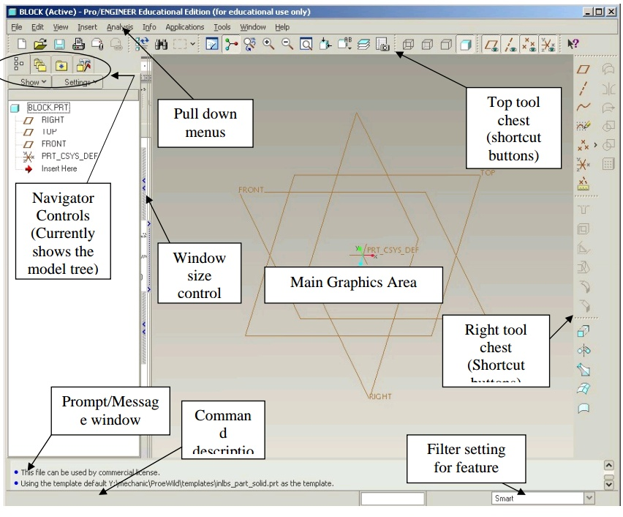

Slide 6
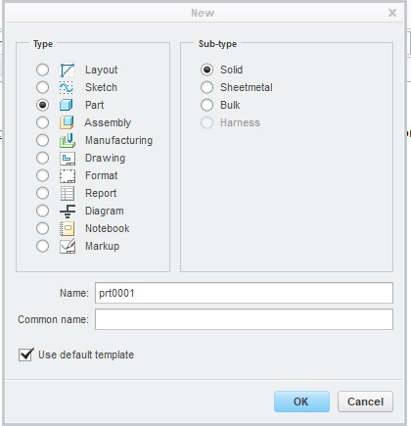
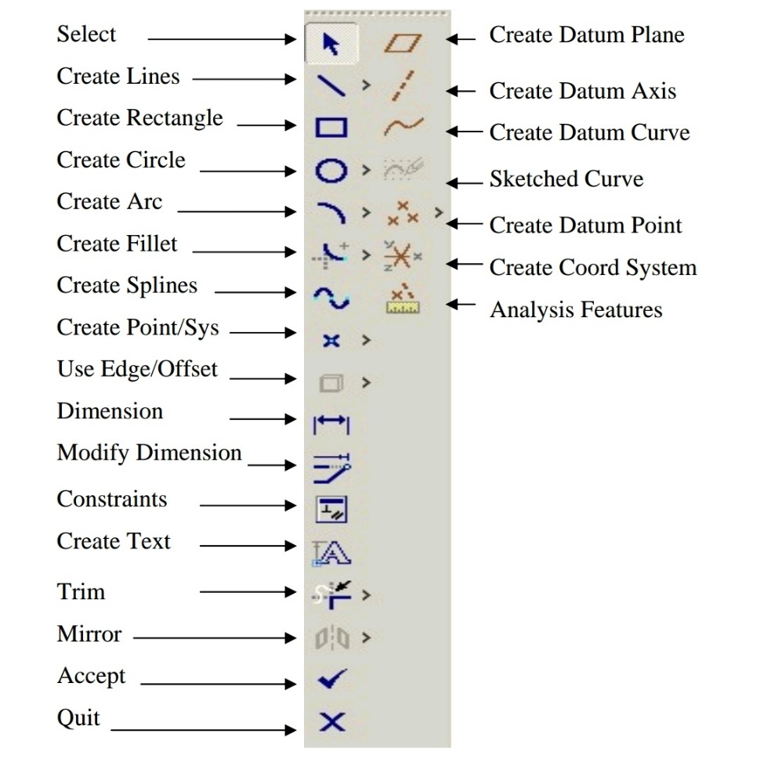

Slide 7
Sketcher in PRO-E:-
PLANE:-this is used to select a plane to draw a sketch.
SKETCH:-this is used to draw a model.
SKETCH VIEW:-this is used to view only two planes in perpendicular.
LINE:- this is used to draw lines and line tangents to the circles.

Slide 8
RECTANGLE:-this is used to draw rectangles but of different types such as CORNER RECTANGLE,CENTRE RECTANGLE,SLANTED RECTANGLE,PARALLELOGRAM.
CIRCLE:-this is used to draw circle of different types such as CENTRE AND POINT CIRCLE,THREE POINT CIRCLE,CONCENTRIC,THREE TANGENT.

Slide 9
ARC:- this is used to draw arcs over the straight lines . there are different types in this they are THREE POINT/TANGENT END,CENTRE AND END,THREE TANGENT,CONCENTRIC,CONIC.
ELLIPSE:- this is used to draw elliptical objects by using different options such as AXIS AND ELLIPSE, CENTRE AXIS ELLIPSE.

Slide 10
SPLINE:- this is used to draw the curves.
FILLET:-this is used to give the circular trim to the lines and there are different kinds of fillets such as CIRCULAR,CIRCULAR TRIM, ELLIPTICAL,ELLIPTICAL TRIM.
CHAMFER:- this is used to give straight edge of two types CHAMFER ,CHAMFER TRIM.
OFFSET:- this gives a same shape but makes difference in heights of the shapes from the reference . This can be done by selecting single line or chain or loop.

Slide 11
CENTRELINE:- this is used as a reference line.
DIVIDE:- this option is used to give points to break the profile.
PROJECT:- this is used to show the line which is used as a reference for the new sketch.
SYMMETRIC:- this is used to make two points or vertices symmetric about the centre line.
NORMAL:-this is used to give the distance between two sketches.

Slide 12
PALETTE:- this is used to import the geometry of a particular standard shapes.
EXTRUDE:- this is used to solidify the sketch which has been drawn for a certain length.
REVOLVE:- this is used to create a profile of 360 angle by drawing a profile by a centre line.
BLEND:- this is used to draw a solid profile by using two different shapes.
HOLE:- this is used to make a hole on the surface of the profile.

Slide 13
SWEEP:- this is used to create using profile.
SHELL:- it used to create the hole from the diagram by adding thickness.
PATTERN:- it used to create instantaneous from the original object.
MIRROR:- it used to create same profile by using reference profile about the central line .

Slide 14
SKETCHER:-here we create 2D diagram.
PART DESIGN:- here convert 2D to 3D surface diagrams.
ASSEMBLY:- here we combine all the 3D parts together to form the final product.

Slide 15
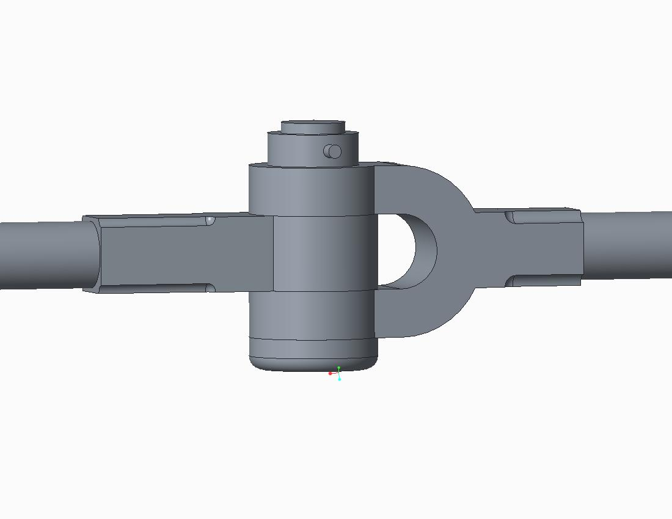
Knuckle joint

Slide 16
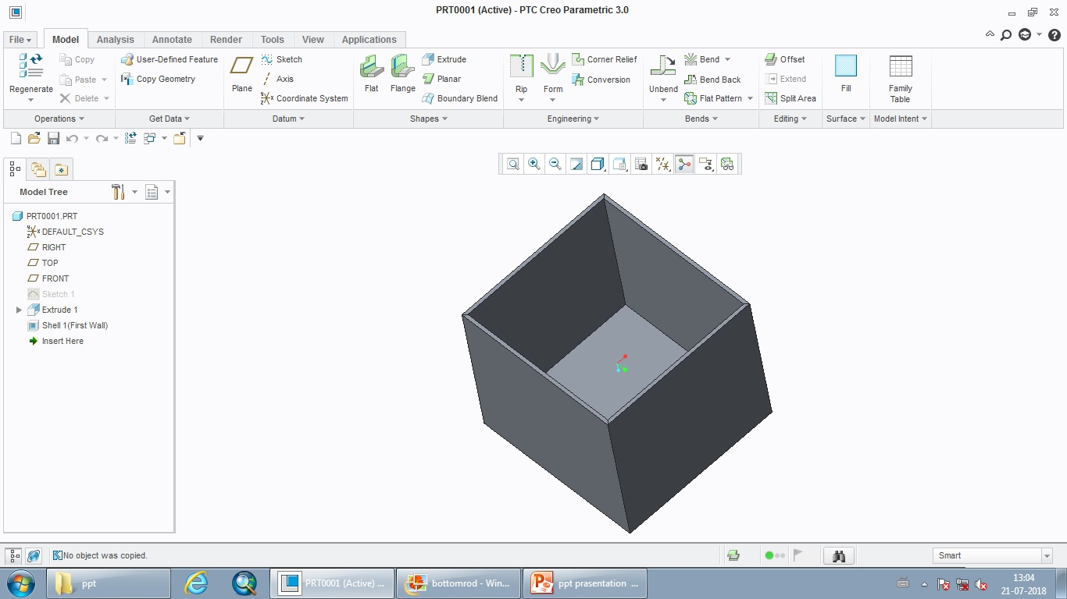
SHEET METAL:- this is used to create the sheet surfaces by converting the solid surfaces.

Slide 17
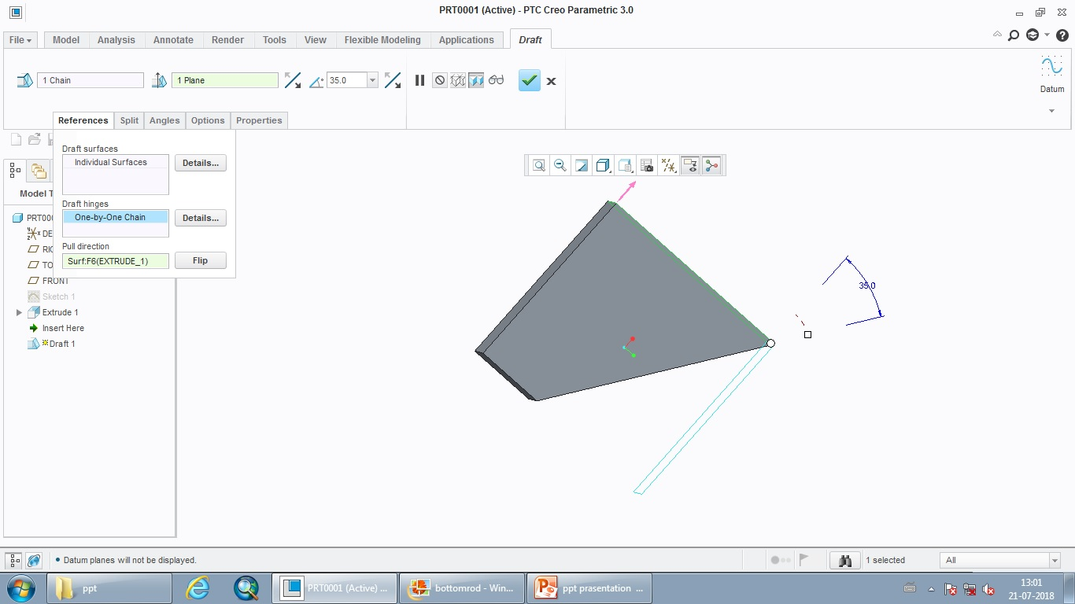
DRAFTING:- here we convert 3D to 2D diagram. Here we generate the views by using 1st& 3rd angle projection.

Slide 18
ADVANTAGES OF PRO-E:-
Steam less data sharing
Late stage change accommodation
Association manufacturing generation & generation of service deliverable are automatic
Language support is offered in 10 different language
Comprehensive training classes available
Command finder features

Slide 19
INTRODUCTION OF ANSYS:-
It was introduced by john Swanson in the year 1970
Experimental:-we used to get accuracy results
Theoretical :-to acquire accurate results it takes lot of time by hand calculator
Numerical :-we can obtain more accuracy results for any complex shapes ,it do not take much time
Nodes :-elements which are inter connected
Elements :-small regular geometry shape

Slide 20
ANSYS MODULES
STATIC STRUCTURAL
STEADY STATE THERMAL
MODEL ANALYSIS
HARMONIC RESONSE
CFX(FLUENT)
EXPLICT DYNAMIC
COUPLE FIELD ANALYSIS

Slide 21
STATIC STRUCTURAL:-
In this analysis system it is used to determine the response of a structural subjected to a static loading condition is does not include damping effect
Find it is used to calculated for displacement ,deformation , stress ,strain forms under different loading condition

Slide 22
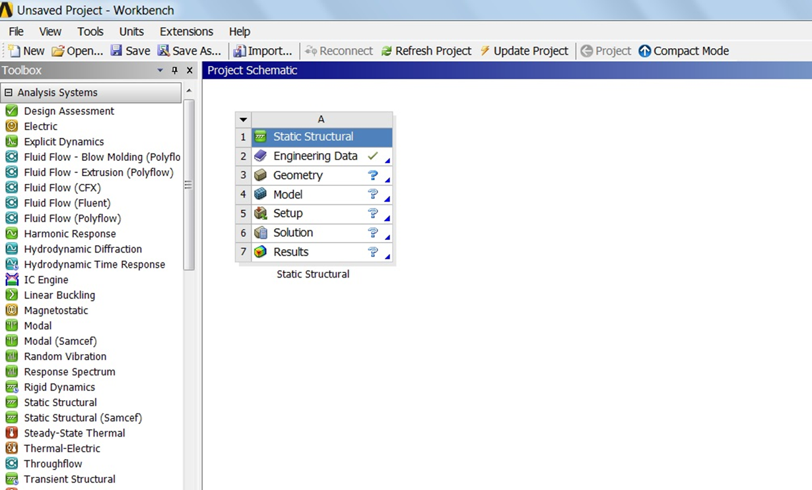

Slide 23
STEADY STATE THERMAL:-it is used to determine the temperature ,heat flow under the influence thermal loading condition
It remain constant with time.
MODAL ANALYSIS:-it is used to determine the vibration characteristics for dynamics loading condition
COUPLEFIELD ANALYSIS:-here we combine two analysis system
Do analysis in steady state thermal and import

Slide 24
Do analysis in steady state thermal and import the data into static structural
EXPLICIT DYNAMICS: this type of analysis known as dynamic analysis
It is used to see the collision between two object.

Slide 25
RICE SEED
SOWINGMACHINE

Slide 26
PARTS OF THE MACHINE MODEL

Slide 27
CONNECTING ROD
This rod is used to connect the wheels & seed holder.
This is mostly made of cast iron as it bares the weight of wheel and holder.
This is made by sweeping a line using circle

Slide 28
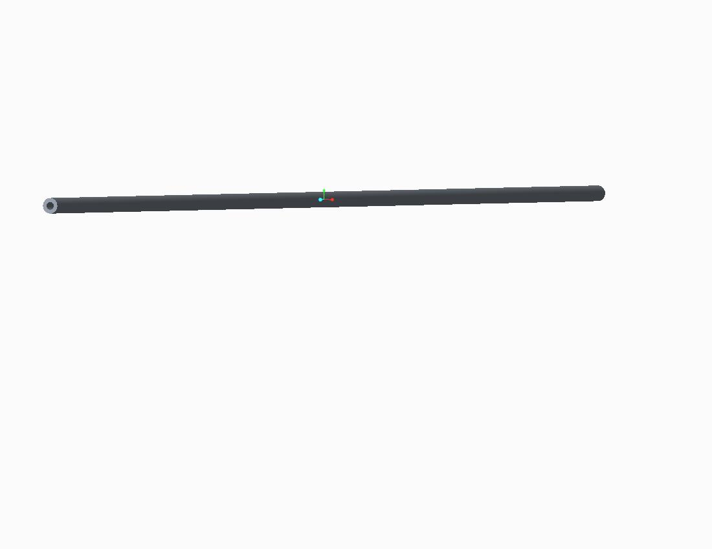

Slide 29
WHEEL
This is used for the motion of the machine .
This is made of plastic material .
the strips over the wheel give vibrations to seed holder to drop seed in it.
This is made by using extrude ,pattern ,circle line .

Slide 30
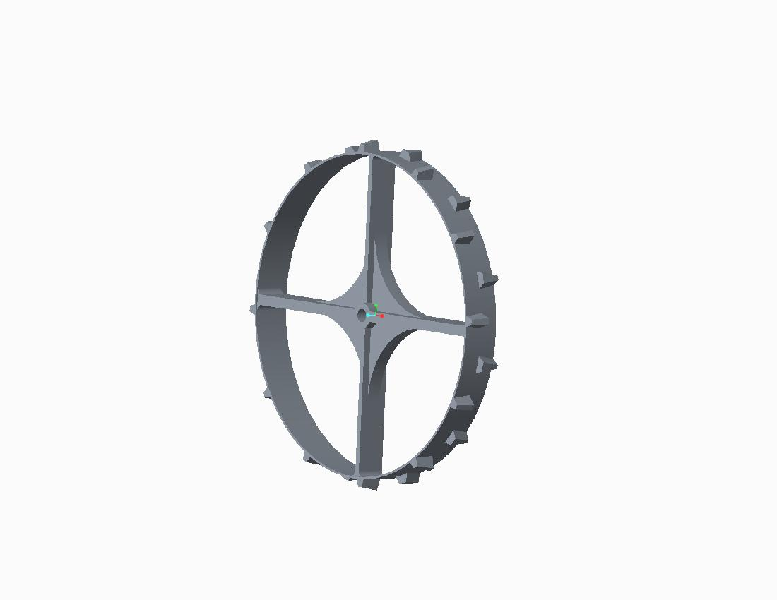

Slide 31
SEED DRUM
This is used for holding the seeds , which are used for sowing.
This is made of plastic.
This consists of bush which is a part of seed drum which gives support to it by giving a good grip to the connecting rod
This is made by using extrude ,blend ,shell, mirror ,pattern ,hole

Slide 32
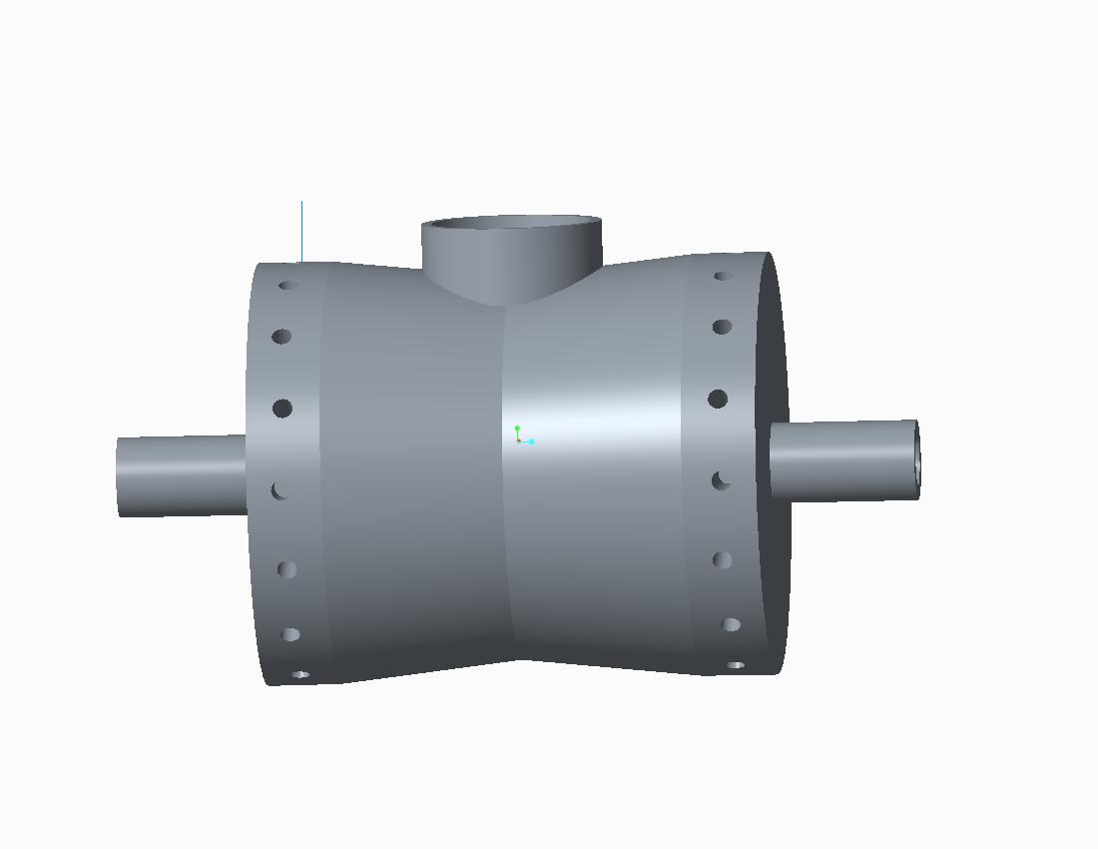

Slide 33
DRUM CAP
This is used for closing the upper hole the seed drum.
This is made of plastic.
This has a good grip by having an extra small surfaces which can used for taking out drum cap.
This is made by using revolve,extrude.

Slide 34
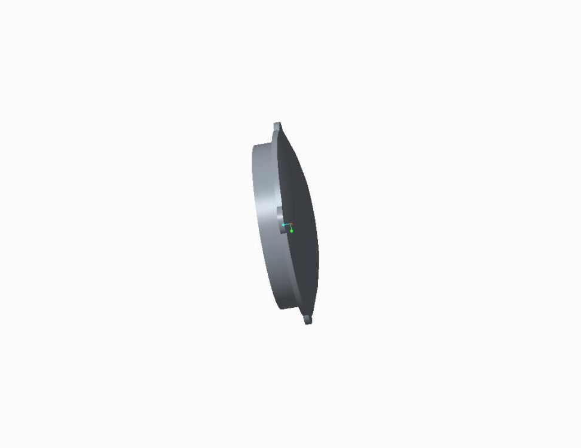
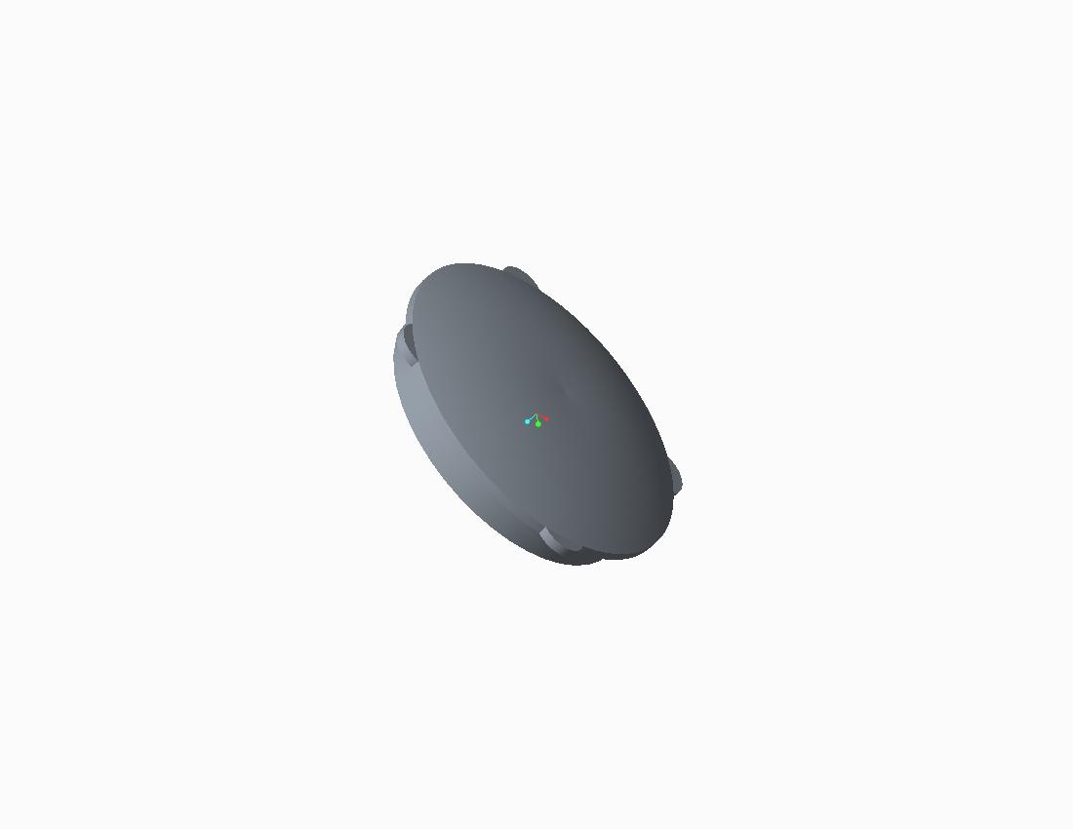

Slide 35
WING BOLT
This is used to join the connecting rod and the wheel.
This is made plastic and cast iron .
This has extra surface over the face ,which gives good grip tighten or loosen the bolt.
This is made by using revolve ,extrude ,pattern.

Slide 36
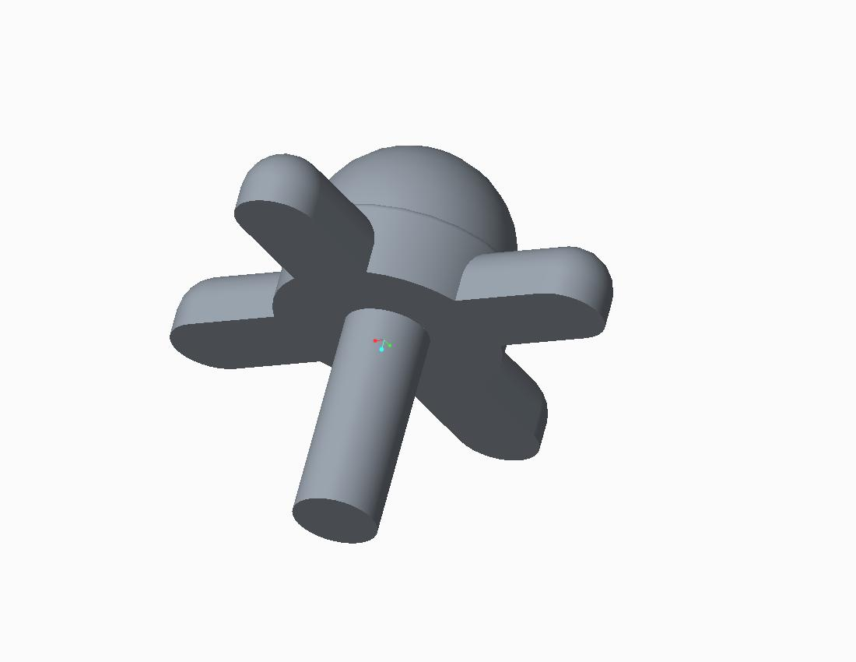

Slide 37
HANDLE HOLDER
This is used for connecting the lower handle and the bush of the seed holder
This is made of plastic.
This is made by using extrude ,extrude cut .

Slide 38
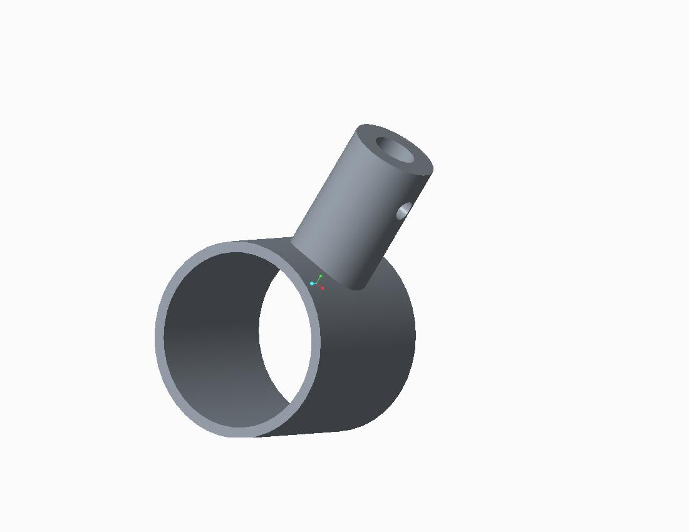

Slide 39
LOWER HANDLE
This is used for the connecting middle handle and the bush.
This is made of cast iron.
This is made by sweeping a line which is in C shape ,extrude cut.

Slide 40
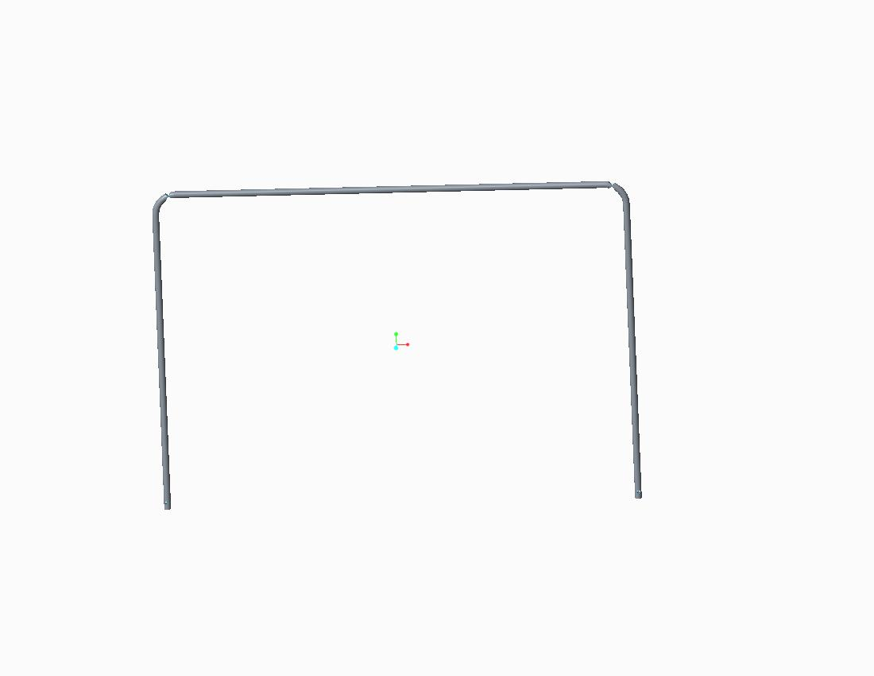

Slide 41
MIDDLE HANDLE
This is used for connecting the lower handle and the upper handle.
This is made of cast iron.
This is made by sweeping a line which is in C shape , extrude cut

Slide 42
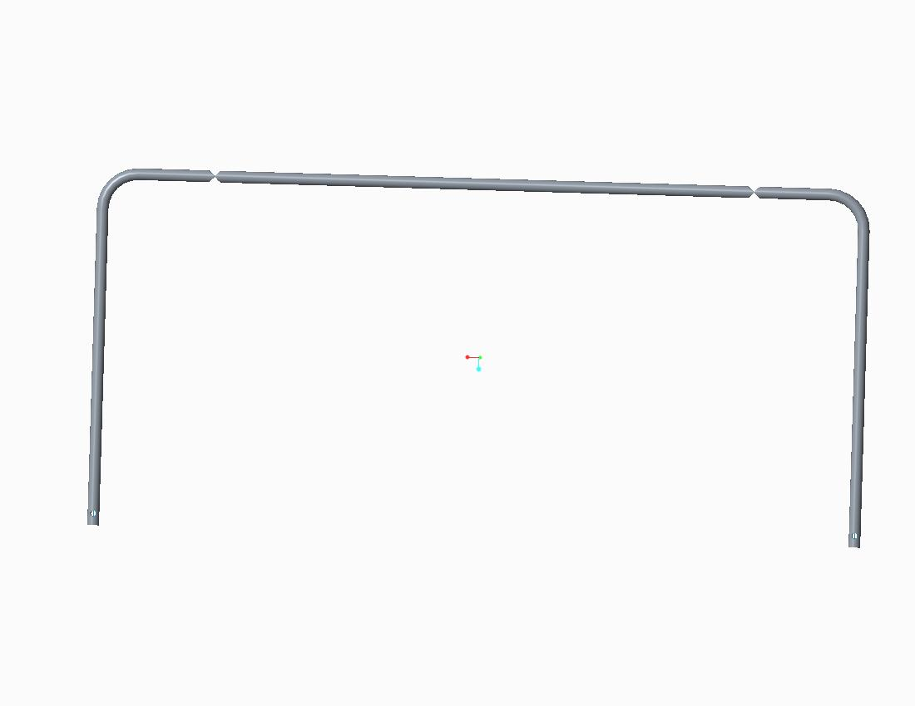

Slide 43
UPPER HANDLE
This is used connect to the middle handle .
This gives perfect handling of machine.
This is made of cast iron.
This is made by sweeping a line which is U shape ,extrude cut.

Slide 44
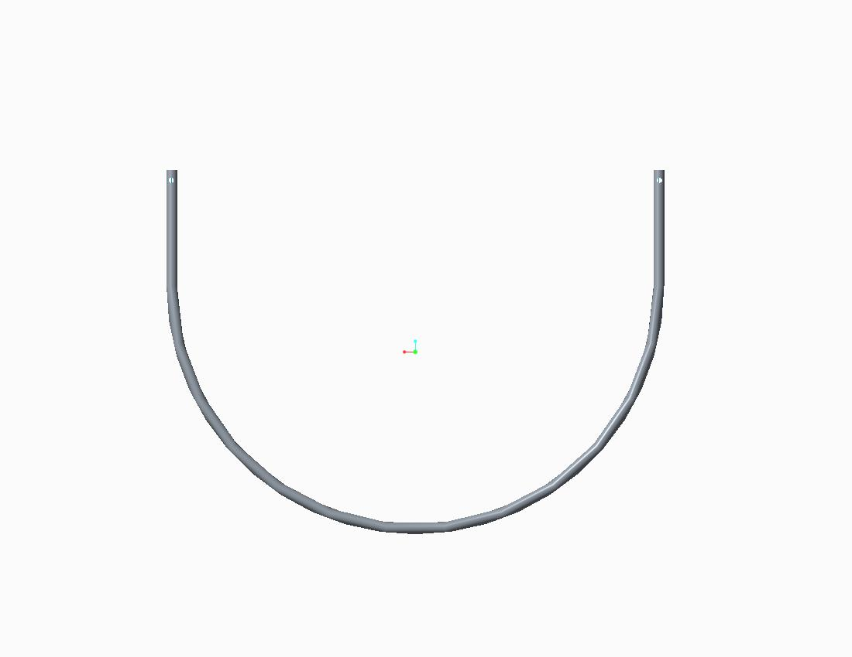

Slide 45
HANDLE JOINER
This is used to connect the handle by using nuts , bolts.
This is made of plastic.
This is made by extrude ,extrude cut.

Slide 46
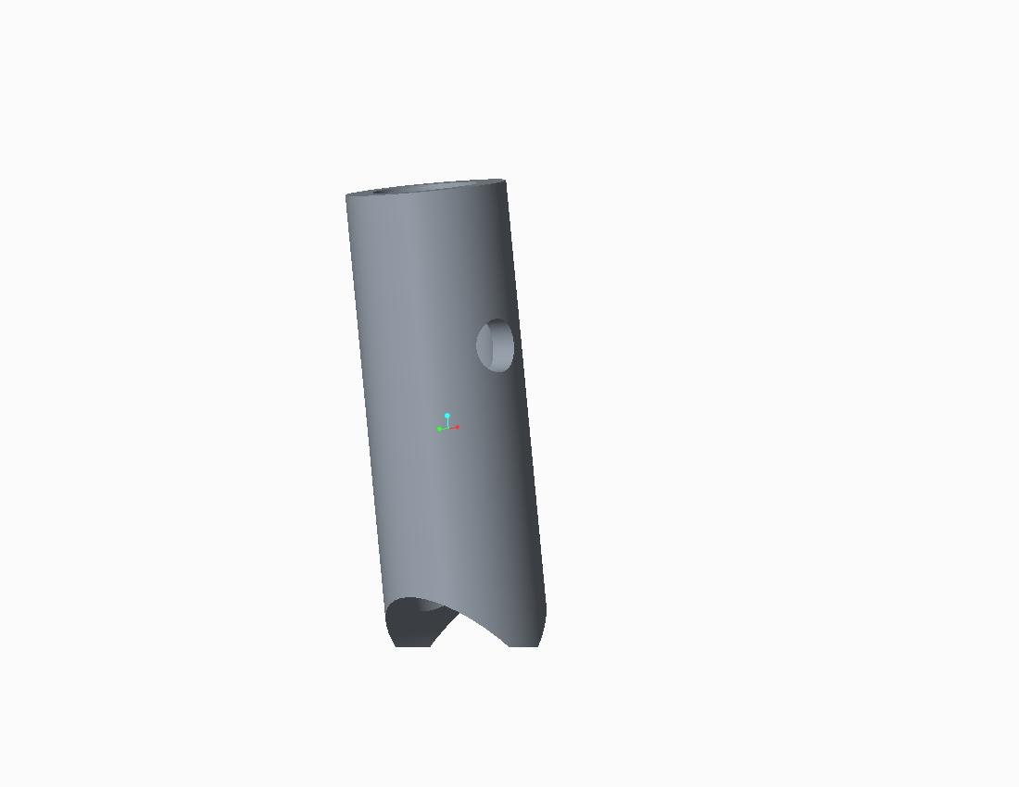

Slide 47
BAFFLES CAPS
This is used to close the baffles which is used to hold seed in the seed holder.
This is made of plastic.
This is made by revolving sketch into the cap

Slide 48
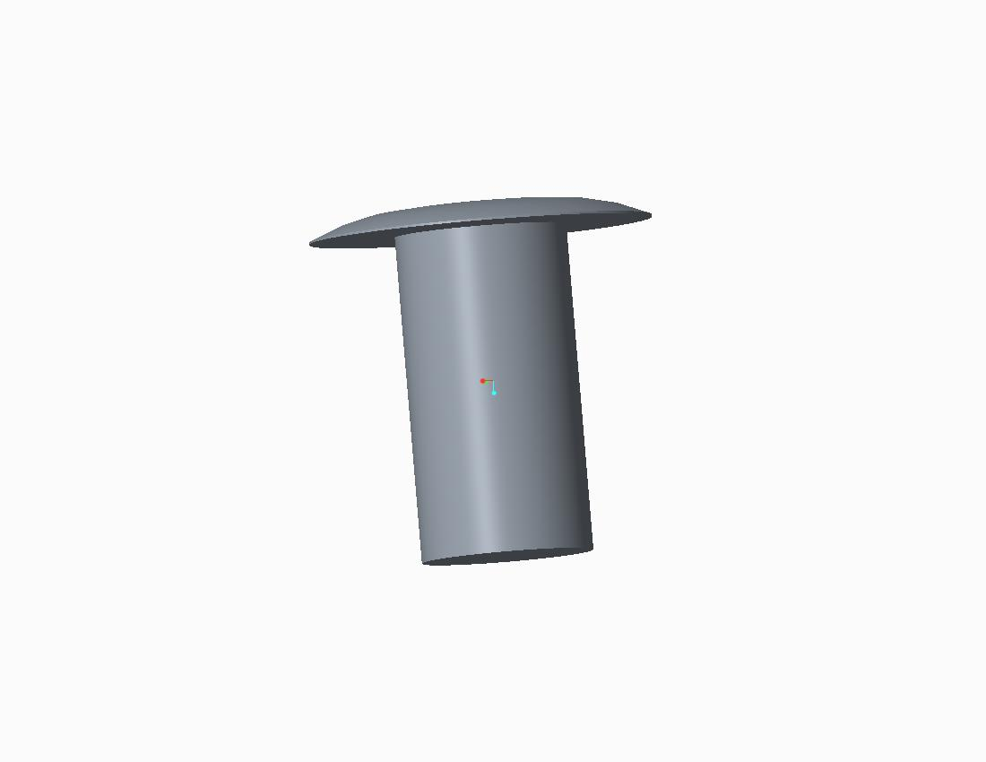

Slide 49
BOLT
This is used to fix the handle parts
This is made up of cast iron.
This is made by tool revolve.

Slide 50
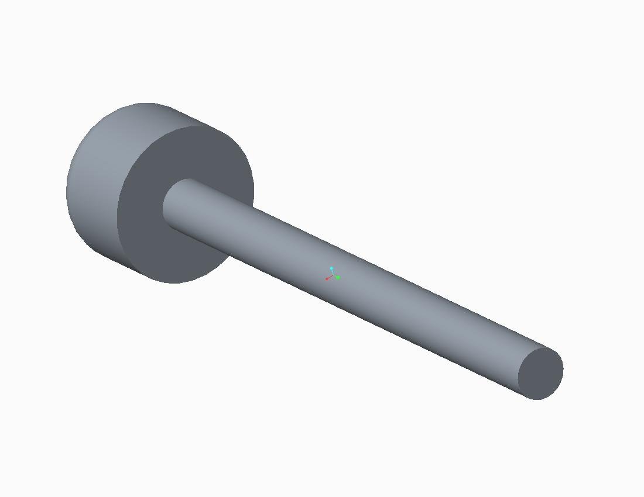

Slide 51
NUT
This is used to connect the bolt and handle joiner.
This is made of cast iron .
This is made by hexagon ,draw the circle & extrude cut revolve cut .

Slide 52
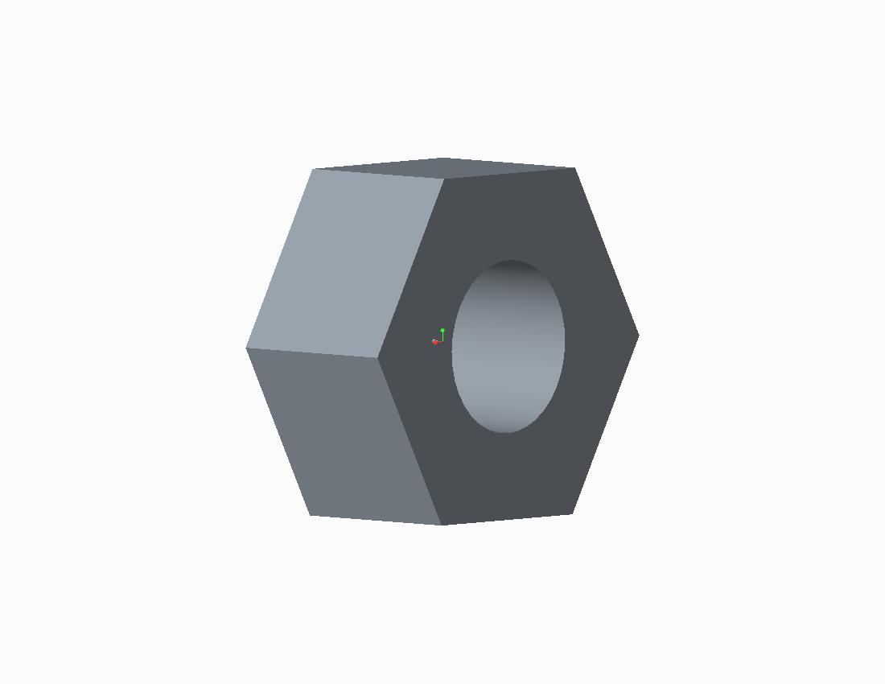

Slide 53
Introduction:-
This is a one type of rice seed sowing machine
It is used to sowing the rice . the machine is offering in tamilnadu
It gets helpful to reduce the manual effort and help farmer
Rice seed sowing machine proves to be practical for uniformity seed sowing

Slide 54
The shape of the seed drum :-hyperboloid diameter of the metering hole :-9mm
Level of filling the seed drum :-half volume
It ids very easy to care and work
This is for sowing germinated
It is manual operated
The Nakhan sawan rice seed centre hopes to introduced a new rice sowing technology

Slide 55
To small scale farmer in an attempt to reduce labour and cost our team evaluated
The current rice planting practices and obtained information
The small farmer ,the rice sowing machine inventor and rice seed centre representatives in order
The recommendation regarding improvements
The current machine and suggest way to initiate the adoption and diffusion process

Slide 56
SPECIFICATIONS
Power source | Hand operated
Row to row spacing | 200mm
Shape of the seed drum | hyperboloid
Number of rows | 8 rows
Diameter of the drum | 200mm
Diameter of the seed metering hole | 9mm
Number of seed metering hole | 9 numbers
Wight of the unit | 10kg
Type of the ground wheel | Lugged wheel

Slide 57
Diameter of the ground wheel | 600mm
Operating seed | 1 kmph
Weight of seed drum | 600mm
Seed requirement | 12-15 kg per acre
Seed preparation | 24 hour socking in the water 12-24 hour incubation
Production capacity | 75,000 no's . Per annum
Material used | Pp cp (polypropylene Co-polymer)
Level of filling the seed drum | Half volume

Slide 58
FEATURES :-
Crop will matures within 7-10 days earlier than the transplanted paddy
Uniformity in seed sowing and plant population will be seen
Continuous drilling of seed is eliminated
Light in weight machinery
It provides consistency

Slide 59
ADVANTAGES OF SEED SOWING MACHINE:-
Labour cost is less
Seeds are exposed
Seeds are presented to fowls ,rats and snails
Seed pre-requisite is more /hectare
Nursery arrangement are not required

Slide 60
ASSEMBLY
step1:-taking the connecting rod as the main body and fixing it.
Step2:- now one wheel is joined to the connecting rod.
step3:-now the wing bolt is attached to the wheel and the rod to fix the wheel.
Step4:-seed holder is joined to the wheel and the connecting rod.

Slide 61
Step5:-another seed holder is fixed next to the previous one and the same process is done another two times
Step6:-now the wheel is connected to the connecting rod.
Step7:-the wing bolt is fixed to the end of the rod.
Step8:- now the handle holder is fixed to bush which is facing the first seed holder of second seed holder.

Slide 62
Step9:-another handle holder is fixed to the seed holder bush which is facing the last one.
Step10:-the lower rod is fixed to the handle holders present over the bushes.
Step11:-the handle joiner is placed over the top lower handle.
Step12:-the middle handle is placed inside the handle joiner .

Slide 63
Step13:-the handle joiners are placed over the middle rod
Step14:-the upper rod is placed over the middle rod by inserting into the joiners.
Step15:-now the bolts are fixed where ever they are required.
Step16:- now the nuts are fixed to the bolts .

Slide 64
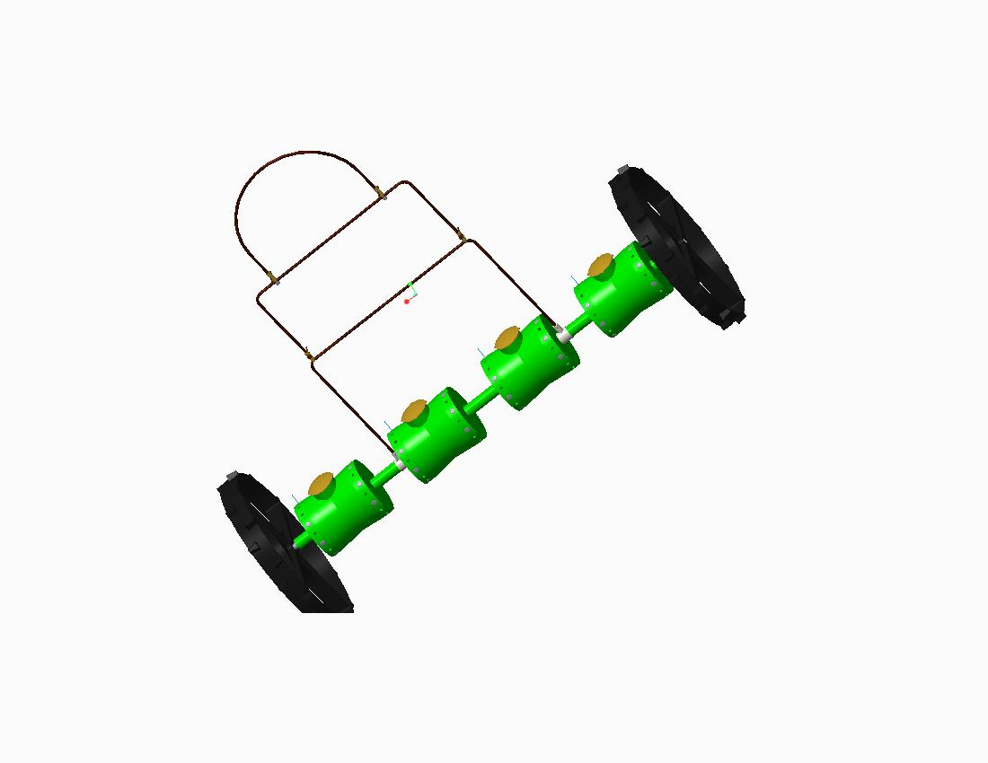

Slide 65
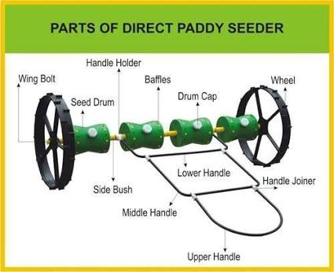

Slide 66
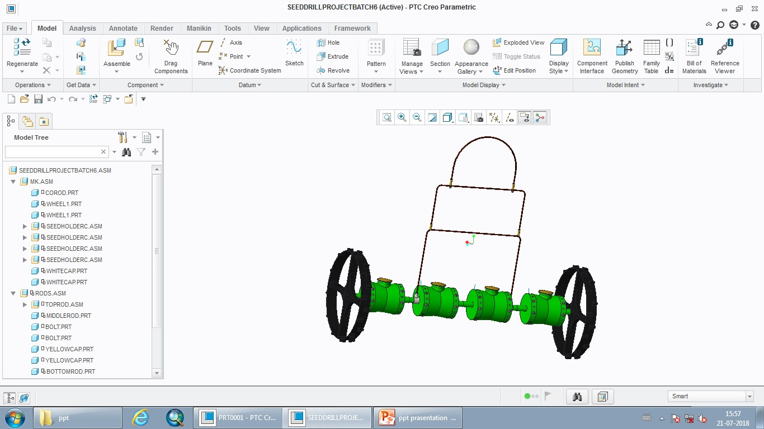

Slide 67
ANSYS OF THE MACHINE MODEL

Slide 68
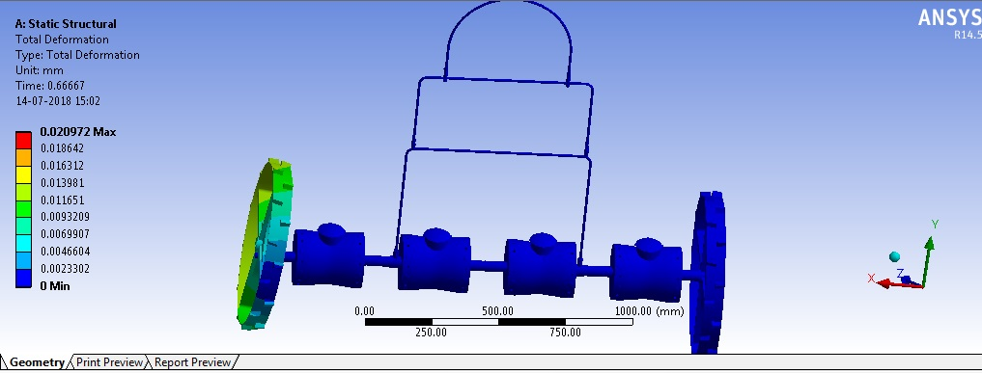
TOTAL DEFORMATION:-

Slide 69
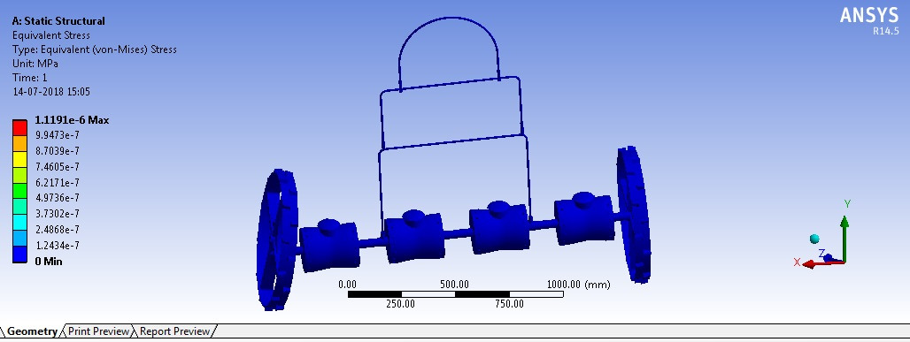
STRESS:-

Slide 70
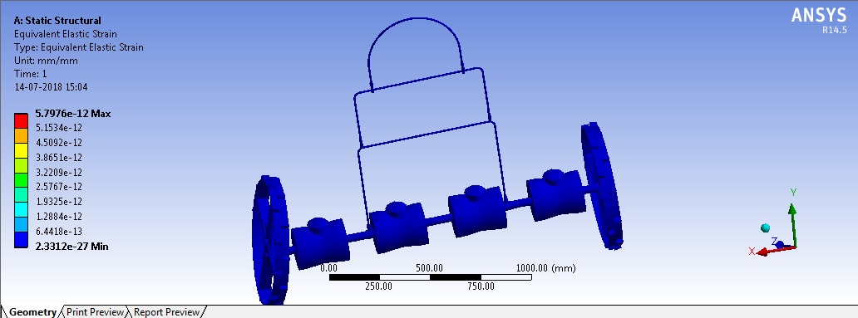
ELASTIC STRAIN:-

Slide 71
THANK YOU
-BY
G.MANOJ KUMAR
K .MOUNIKA
A.NAGARAJU
V.NAVYA
P.PRANAV ADITYA

